Slide 1
A new prevention campaign to educate young people and parents about the risks of alcohol use

Slide 3
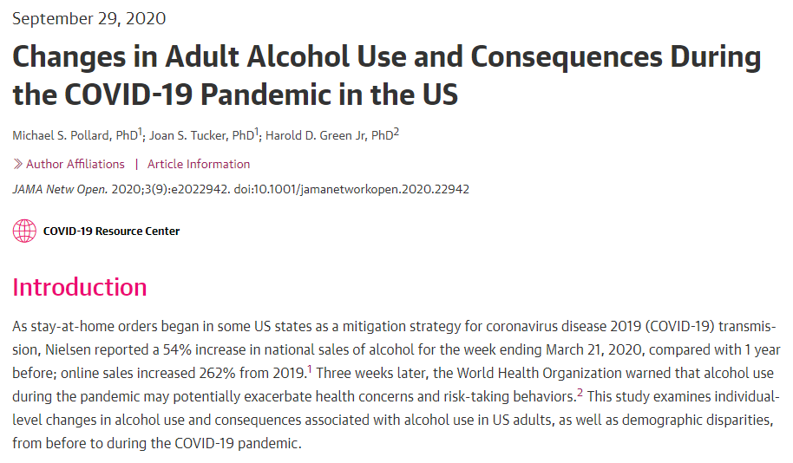
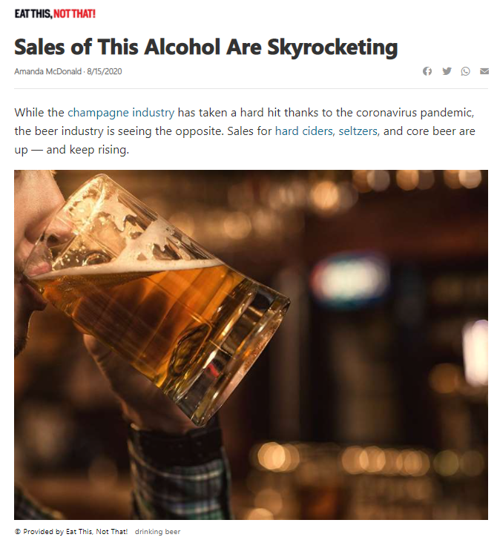
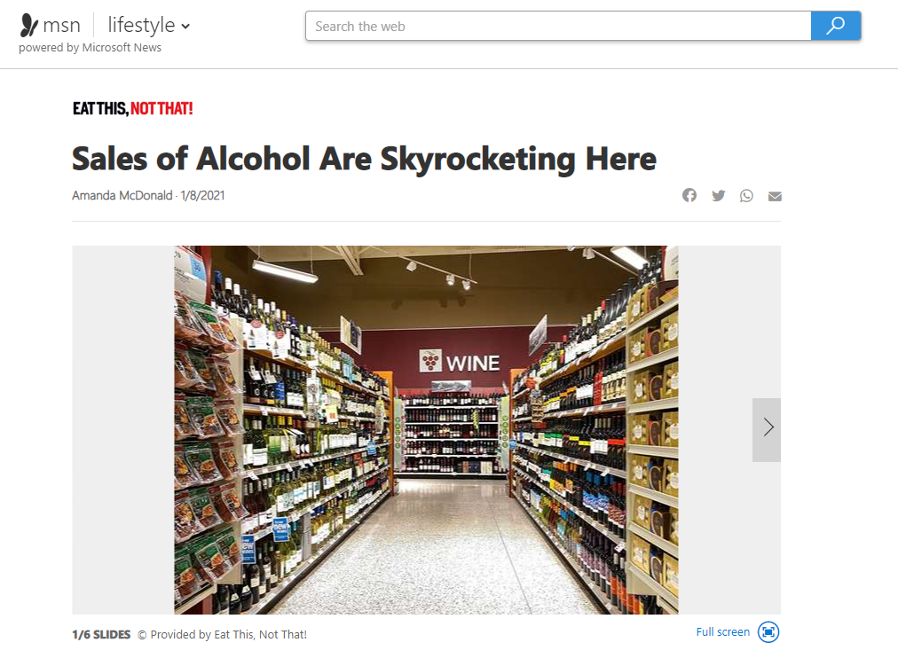
Alcohol Use is Skyrocketing
The pandemic led to relaxed guidelines around alcohol purchases
This presents a huge risk!
Online sales of alcohol in the U.S. is up 80%*
80%
*Source: (IWSR, 2021)

Slide 4
What You Can Do

Slide 5
What You Can Do
Talk with friends and family about the risks of alcohol use and COVID-19
Alcohol use can:
Worsen lung damage and injury
Lower your immune response to viruses
Increase inflammation in many areas of the body
Alter your thoughts, judgement, and decision making

Slide 6
What You Can Do
Talk with friends and family about the risks of alcohol use and COVID-19
Alcohol may cause or worsen:
Anxiety
Depression
Poor sleep
Stress
Suicidal thoughts

Slide 7
Parents and Young People

Slide 8
Parents
Role model positive behavior
When kids see risky behavior from adults, it can lead them to their own unhealthy choices
Most teens say their parents are the main influence on their decisions about drinking alcohol

Slide 9
Parents
Secure alcohol safely and lock it up
The most common way for young people to access alcohol is in the home
Kids who are allowed to drink at home are more likely to have problems with alcohol later in life

Slide 10
Young People
Practice healthy habits to cope with stress
Exercise regularly
Drink water
Get plenty of sleep
Avoid or limit alcohol use
Drinking is NOT a healthy coping strategy!

Slide 11
How You Can Help

Slide 12
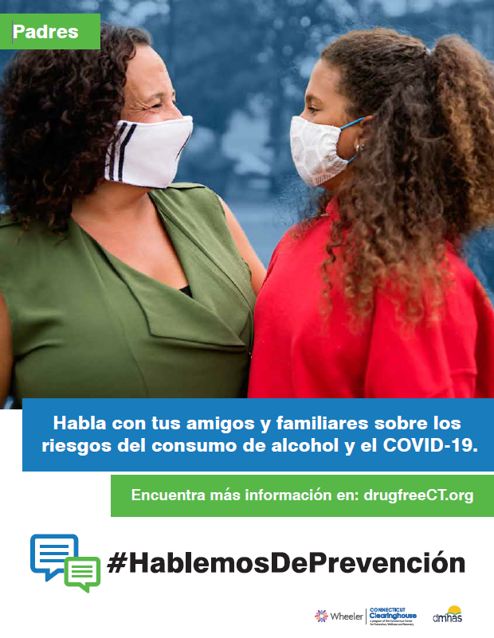
How You Can Help
Access a FREE alcohol misuse prevention toolkit at drugfreect.org
Digital toolkit offers:
Resources for the general public
Flyers, videos, social media graphics, and more
Downloadable, shareable files
English and Spanish versions
Add your prevention council logo to digital flyers and resources!
Spanish Flyers
Flyers
Posters

Slide 13
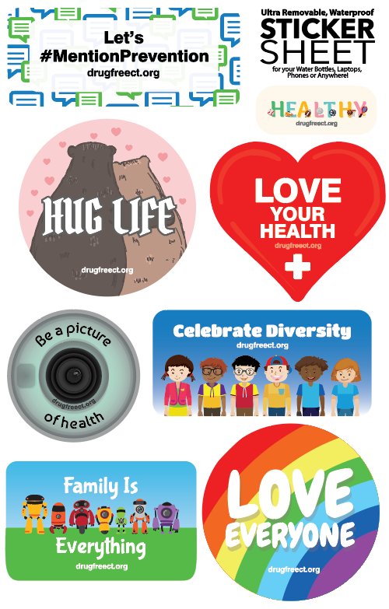
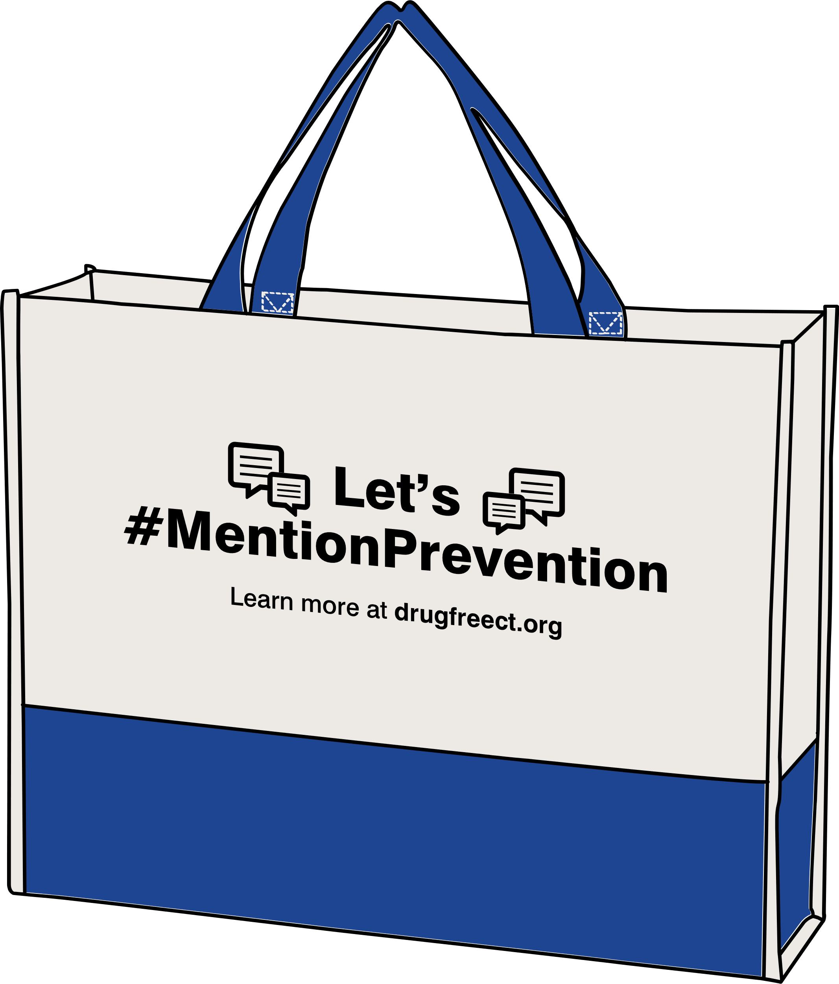
How You Can Help
Access a FREE alcohol misuse prevention toolkit at drugfreect.org
Order promotional items:
Liquor stickers
Magnets
Pens
Sticker sheets
Tote bags
Use these items to raise awareness in your community!
Tote Bags
Pens
Magnets
Liquor Stickers
Stickers Sheet

Slide 14
How You Can Help
Share the videos in the toolkit with your community
Click on Video to Play

Slide 15
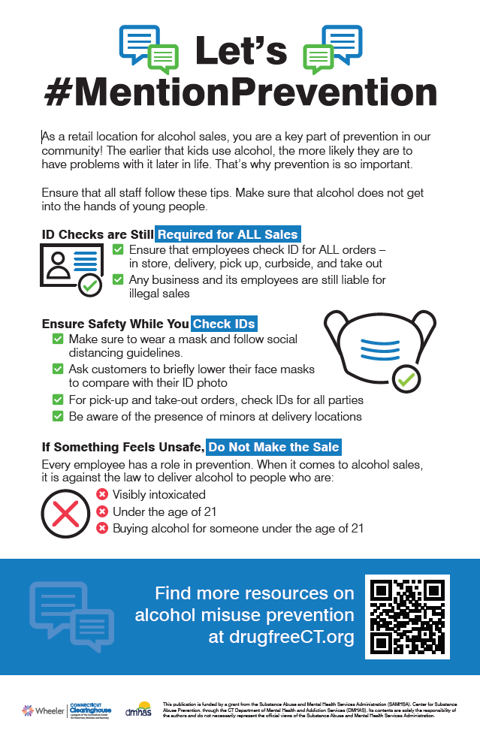
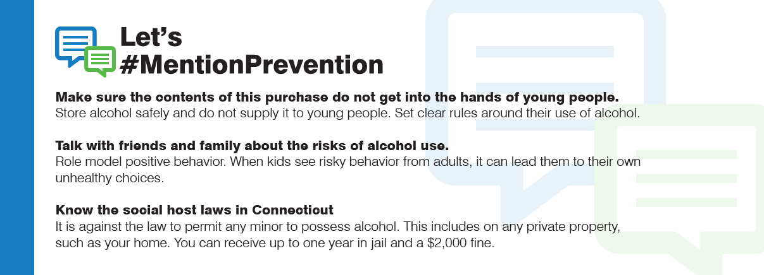
How You Can Help
Use the FREE alcohol misuse prevention toolkit to engage alcohol retailers
Resources for alcohol retailers:
Poster for employees
Bag insert for customers
Register decal
Window cling
Add your prevention council logo to print-ready files!
Register decal
Bag insert
Window cling
Retailer Poster

Slide 16
How You Can Help
Share the toolkit resources with:
- Parents
- Young people
- Educators
- Retailers
- Health care providers

Slide 17
Additional Resources

Slide 18
Learn More About Alcohol Use
Alcoholscreening.org
Learn about the severity and risk level of alcohol use
Alcoholtreatment.niaaa.nih.gov
Find answers to many common questions about treatment
Refer people to these links to find credible, reliable, evidence-based information

Slide 19
Find Help During a Crisis
211ct.org
dial 2-1-1
CT Department of Mental Health and Addiction Services
ct.gov/dmhas
(800) 563-4086
During a crisis, use this information to find help no matter where you are in Connecticut

Slide 20
Learn more at drugfreeCT.org

