Slide 1

Everyone has a Role in PREVENTION
When we prevent substance use and support people in recovery, it has positive impacts
Notes:
TALKING POINT RECOMMENDATIONS
Start the meeting by reinforcing that the purpose of the meeting is to share important information about substance use, and that we all have a role in preventing overdoses
Mention that the meeting will help everyone understand how to support any of our fellow employees or loved ones in treatment or recovery

Slide 2

Why We Must Talk About PREVENTING OVERDOSES
75% of employers have been directly affected by opioids
Source: National Safety Council
Notes:
TALKING POINT RECOMMENDATIONS
Explain that the vast majority of workplaces are impacted by substance use, and opioids in particular
Every person take actions to help reduce the risks of overdoses in the workplace
Change the Script is a public health campaign here in Connecticut to help residents of our state reduce the risks of overdoses – it is created by the Connecticut Clearinghouse and the CT Department of Mental Health and Addiction Services

Slide 3

The Risks of Substance Use
Affect EVERY WORKPLACE
75%
of adults who have substance use disorders are part of the U.S. workforce
Substance use is a serious public health issue. We may have coworkers right beside us who are in treatment and recovery. Industries most affected include:
Construction and trades
Services, including foodservice
Transportation
Installation, maintenance, and repair
Sales
Entertainment, sports, media, communications
Production, machinery setters, operators, tenders
Executive, administrative, managerial, financial
Farming, fishing, forestry
Source: National Safety Council
Notes:
TALKING POINT RECOMMENDATIONS
Explain that substance use affects businesses in every market sector and industry
Mention that the majority of adults who are in treatment or recovery from substance use disorders are active employees across all those market sectors and industries

Slide 4


Many People are in TREATMENT AND RECOVERY
9% of the U.S. workforce had a substance use disorder in the past 12 months
Source: National Safety Council
Notes:
TALKING POINT RECOMMENDATIONS
The statistic on this slide echoes the points from the last slide – a significant number of employees in the U.S are in treatment and recovery for substance use disorders

Slide 5


Let’s Protect and Support People in
THIS WORKPLACE
All employees are important. Everyone deserves respect and support. That’s why it’s important to create a workplace that supports employees in recovery. When we do that, it has a positive impact on the bottom line.
Notes:
TALKING POINT RECOMMENDATIONS
Emphasize that it is critical to support our fellow employees
Supportive coworkers can be one of the reasons that someone decides to seek help
Mention that there are positive business reasons to take this approach

Slide 6

DID YOU KNOW?
Employees in recovery miss
14 LESS DAYS
per year
Source: National Safety Council
Notes:
TALKING POINT RECOMMENDATIONS
Highlight that less missed work time means more take home pay for hourly-wage employees

Slide 7

There are Positive Impacts
for EVERYONE
22 million+
people in the U.S. are in recovery for a substance use disorder
Employers and employees both benefit when we prevent substance use, avoid the risks of overdose, and support people in recovery.
Better performance
Fewer accidents
Greater loyalty
Higher productivity
Less turnover
Lower health care costs
More long-term employees
Reduced costs to train new hires
Source: Recovery Research Institute
Notes:
TALKING POINT RECOMMENDATIONS
Highlight these positive reasons for your workplace to support employees who are in treatment and recovery
The statistic on this slide reinforces that many people are in recovery and are part of the workforce

Slide 8

DID YOU KNOW?
Each employee in recovery saves a company an average of
$8,500 annually
Source: National Safety Council
Notes:
TALKING POINT RECOMMENDATIONS
Emphasize that supporting employees in recovery has positive financial impacts for both businesses and employees
This savings is due to lower health care costs, less productivity that is lost, less resources needed to hire and train new employees, and more.

Slide 9



What YOU CAN DO
Keep Your Prescriptions Secure
Don’t share them with anyone or let others access them. Use a medication lock box to store them safely.
Only Take Medication Prescribed For You
Use it exactly as directed. Even if you have a prescription, it’s risky to use it in ways other than directed by a doctor.
Help Reduce Stigma
Talk with those in need. Help people find treatment. Support them in recovery.
Notes:
TALKING POINT RECOMMENDATIONS
Here are concrete steps that every person in your workplace can take to reduce the risks of overdoses and support coworkers in treatment and recovery

Slide 10



Important Resources
TO FIND HELP
Connecticut Department of Mental Health and Addiction Services
(800) 563-4086
SAMHSA's National Helpline
1-800-662-HELP (4357)
National Alliance on Mental Illness HelpLine
(800)-950-NAMI (6264)
National Suicide Prevention Lifeline
(800) 273-TALK (8255)
Notes:
TALKING POINT RECOMMENDATIONS
Emphasize that these are places that anyone can contact any time that they need help for substance use or mental health concerns

Slide 11



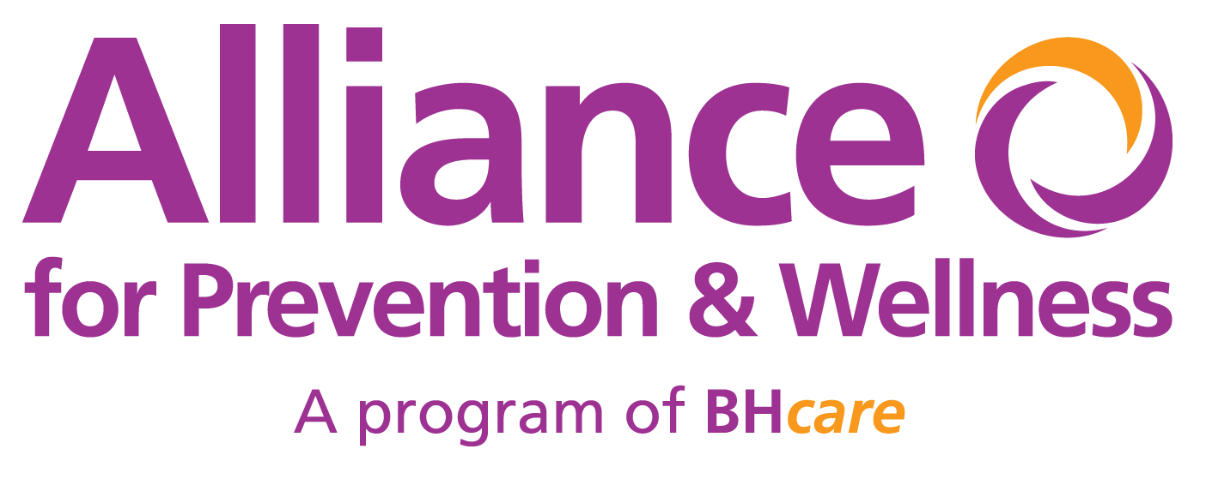


Important Resources
TO FIND HELP
Supporting and Engaging Resources for Action and Change
Eastern CT
Amplify, Inc.
North Central CT
Alliance for Prevention & Wellness
South Central CT
The Hub
Southwestern CT
Western CT Coalition
Western CT
Notes:
TALKING POINT RECOMMENDATIONS
Highlight that these are Regional Behavioral Health Action Organizations based right here in Connecticut
Anyone can contact these RBHAOs to find help for substance use or mental health concerns

Slide 12






Change the Script
RESOURCES
FREE Promo Items
Order pens, gaiters, hot/cold packs, medication disposal pouches, and more.
Digital Toolkit
Download social media graphics, flyers, billboard creative, videos, and other materials.
Resource Van
Schedule the Change the Script mobile van to appear at an event, business, school, or organization.
drugfreect.org/cts-toolkit
Notes:
TALKING POINT RECOMMENDATIONS
The Change the Script campaign offers free promo items for employees, such as neck gaiters, hot/cold packs, and more
You can download digital materials for more information about how to prevent overdoses, or you can schedule the Change the Script van to visit your workplace and distribute information
Simply scan the QR code with your phone camera to link directly to the website

Slide 13

Create a Recovery Friendly WORKPLACE
When we prevent substance use and support people in recovery, it has positive impacts
Notes:
TALKING POINT RECOMMENDATIONS
Remind everyone again that there are positive reasons to create a workplace that supports people in recovery

Slide 14

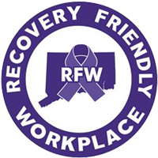
How You Can
SUPPORT RECOVERY
Positivity
has significant benefits for employers, employees, and all stakeholders
Connecticut has a Recovery Friendly Workplace initiative that provides an array of tools and resources to guide you. Take the steps to support employees in the workplace.
It can lead to better morale, loyalty, and performance
It’s good economic policy, helps mange health care costs, and much more
Notes:
TALKING POINT RECOMMENDATIONS
You can access a digital toolkit that guides your business on how to create a Recovery Friendly Workplace
Simply scan the QR code with your phone camera to link directly to the website

Slide 15

THANK YOU
Visit drugfreect.org or scan the
QR codes to find more resources
Businesses
drugfreect.org/cts
Employees
drugfreect.org/work
Notes:
TALKING POINT RECOMMENDATIONS
Close the meeting by thanking people for their time and inviting them to simply scan the QR codes with their phone cameras to find more information

